Slide 1
Dealing with the Problem of Abrasive Leaders
Laura Crawshaw, Ph.D., BCC
Founder
The Boss Whispering Institute
Portland, Oregon
www.bosswhispering.com

Slide 2

Founded in 2009
Mission: To reduce suffering in the workplace caused by abrasive leaders
Dedicated to research & training in the field of coaching abrasive leaders
Method: Designed to increase empathy & resulting psychological insight
Based upon Dr. Crawshaw’s research coaching over 400 abrasive leaders (including professionals such as physicians, academics, and attorneys).

Slide 3
Abrasive Leader
Any individual charged with managerial authority whose interpersonal behavior causes
emotional distress in coworkers sufficient
to disrupt organizational functioning.
They rub their coworkers the wrong way

Slide 4
What They Do
Overreact
Over-control
Threats
Public humiliation
Condescension

Slide 5
Impact of Abrasive Leaders
Center for Creative Leadership survey: 74% of successful executives had at least one intolerable boss
Gallup survey: Main reason people quit
Absenteeism
Lowered morale/productivity
Increased legal actions
Retaliation: sabotage, homicide

Slide 6
Abrasive Leaders: Common Assumptions
Fully aware of nature and impact of abrasive behaviors
Intent: malevolent (to harm)
Means: dominate (exert control) through aggression/intimidation
Behavior is intractable: they cannot change

Slide 7
Abrasive Leaders: Research Findings
Little or no awareness of nature and impact of abrasive behaviors – they’re clueless
Intent: to “do what it takes to get the job done”
(They are defending against the threat of being perceived to be incompetent) - they’re afraid
Means: dominate (exert control) through aggression/intimidation
Behavior is coachable: they can change

Slide 8
What Adequate Leaders Do
See a problem
Explore cause of problem
Employee is unable
Employee is unwilling
Address problem
Provide resources, training
Set limits & consequences

Slide 9
What Abrasive Leaders Do
See a problem
Diagnose incompetence
“stupid”, “lazy”
Attack incompetence
Dominate through intimidating “threat displays” (bullying)

Slide 10
Laws of the Wild & the Workplace
Bears & abrasive leaders just want to go about their business
Their business is survival
Dominance pays (superior “fitness” = survival)
They defend against threats to their survival, whether in the wild or the workplace, with aggression.
You’ll pay if you get in their way

Slide 11
In The Wild: The Survival Dynamic
THREAT => ANXIETY => DEFENSE
(TAD© Dr. Laura Crawshaw)

Slide 12

TAD© Dynamic
FIGHT
THREAT => ANXIETY => DEFENSE
FLIGHT

Slide 13
At Work: The Survival Dynamic
THREAT =>
ANXIETY =>
DEFENSE
(TAD© Dr. Laura Crawshaw)

Slide 14
As Humans: The Third Option
THREAT =>
ANXIETY =>
WORKING THROUGH
THREATENING ISSUE RATIONALLY

Slide 15
TAD Dynamic vs. Working Through
FIGHT
THREAT => ANXIETY => DEFENSE
FLIGHT
WORKING
THROUGH

Slide 16
Abrasive Leaders
PERCEIVE A
THREAT
TO THEIR
COMPETENCE
DEFEND AGAINST
PERCEIVED
THREATS
WITH
AGGRESSION
=>

Slide 17
Blinder Than Bats: Why They Don’t See
Lack social sonar (empathic capacity)
Don’t “read” emotions
Discount importance of emotions

Slide 18
How does management respond to abrasive leaders? They take “flight”
Whence fleeth management?

Slide 19
To → Department of Human Resources
HR!!!

Slide 20
Management’s (Flight) Defense Mechanisms
Rationalization:
“It’s just a personality conflict.”
“Nobody’s perfect – including myself.”
Projection:
“He’s just got some difficult employees.”
Minimizing:
“He doesn’t blow up that often.”
“You’re making too much of this.”
Procrastination:
“It won’t be long before she retires.”

Slide 21
Why don’t employers intervene?

Slide 22
Prevailing Theories about Employers
They’re evil
They condone it

Slide 23
Truthfully: Afraid, Hopeless & Helpless
Fear of being harmed or doing harm
Failure of past intervention efforts
Ineffective management training
Blocked by abrasive leader’s denial of behaviors
Focus on evidence vs. negative perceptions
Belief that people can’t change
Belief that sole option to end workplace bullying is termination
Hope => Empowerment => Intervention

Slide 24
What Employers Have To Do
INTERVENE
Make them see the impact of their behavior
Make them care enough to want to change
Offer help

Slide 25
Intervention Step 1: Make them see the impact of their behavior
Employees should be evaluated on their technical performance and interpersonal conduct
Detect & document chronic pattern of negative perceptions
Present pattern of negative perceptions to abrasive leader as evidence of unacceptable conduct
“ We’ve had a steady stream of complaints from coworkers about their experiences interacting with you – we don’t see this with other faculty (or administrators). This is not acceptable and cannot continue. We need to have you turn this around.”

Slide 26
Avoid “Fact Battles”
Don’t get pulled into defensive “fact battles” of “what really happened” or “who’s really at fault”.
Instead:
“The fact is that we don’t know and cannot know exactly what happened — we weren’t there when the incidents occurred. But we do know one thing for a fact: your coworkers feel they are being treated disrespectfully and this cannot continue.”

Slide 27
Intervention Step 2: Make them care enough to want to change
Set limits
“The way you interact with others has to change.”
Set consequences
“Failure to do so will result in…

Slide 28
Intervention Step 3: Offer help
Individualized program:
Internal mentoring
External specialized coaching
(such as Boss Whispering©)

Slide 29
HR’s Role:
Detect & document chronic patterns of negative perceptions
Explore reports of abrasive conduct (aka workplace bullying)
Intervene with management
Make Management see that they can & should hold leaders accountable for acceptable conduct
Make Management care enough to set limits & consequences (predict future consequences of failing to intervene)
Offer hope and help
EARLY INTERVENTION PREVENTS FUTURE DAMAGE

Slide 30
How does specialized coaching work?

Slide 31
Boss Whispering© = Action Research “Self-reflective enquiry undertaken by participants in social situations …..”
What are the negative perceptions?
What is causing them?
What strategies can we develop to eliminate these negative perceptions permanently?

Slide 32
Abrasive leaders lack psychological insight:
Poor empathizers
“I don’t get it. When I ask my team for input, no one speaks up.”
“Why do you think that is?”
Theory 1: “They’re lazy”
Theory 2: “They’re stupid”

Slide 33
Boss Whispering© Step 1: Coach moves quickly to establish trusting alliance with Client
“I’d like you to engage me as your co-researcher so that we can discover the exact nature of these damaging negative perceptions, and determine what generates them.”
“Once we do that, we can then work to develop strategies to eliminate these negative perceptions.”
“This is a confidential process: I do not share our findings or work with anyone.”

Slide 34
Boss Whispering© Step 2: Coach conducts Coworker Assessment to provide detailed feedback
Coworkers are individually interviewed by Coach
Data is purged of identifying information & aggregated into themes (“Over-controls”, “Doesn’t listen” “Publicly humiliates”, etc.)
Confidential feedback data is reviewed
Client learns exactly what he/she does or says that generates interpersonal distress (the negative perceptions)
Coach & Client determine which theme to address first

Slide 35
THEME: “Publicly Humiliates”
“ He will dress people down with other employees present.”
“In a meeting he told one person they were worthless.”
“If someone makes a mistake, he’ll bring it up in meetings – he’ll say ‘How did you ever come up with a stupid idea like that?’
“If somebody says something that he perceives as contradictory, he enjoys humiliating you, like a cat toying with a mouse.”
“People are terrified to say anything – they just clam up”

Slide 36
Boss Whispering© Step 3: Client learns to read and accurately interpret coworker behavior (develop empathic accuracy) using the T-A-D Dynamic
FIGHT
THREAT => ANXIETY => DEFENSE
FLIGHT

Slide 37
Abrasive leaders gain psychological insight
“I don’t get it. When I ask my team for input, no one speaks up.”
“Why do you think that is?”
Theory 1: “They’re lazy”
Theory 2: “They’re stupid”
Theory 3: “They’re afraid! Now I get it: they’re afraid I’ll criticize them.”

Slide 38
Boss Whispering© Step 4: Developing & Testing Insightful Strategies
What strategies could reduce the perception of threat?
“If I have a problem with someone, I could address it behind closed doors.”
“I can’t call people names.”
“If I think someone has a stupid idea, I need to bring them around without making them feel stupid.”
Client shifts from Attacking to Educating

Slide 39
The Insight Cycle
Analyze behavior w/ TAD Dynamic©
Develop theory on nature of anxiety
Develop strategy to reduce anxiety
Test strategy
Observe behavior

Slide 40
Boss Whispering©
Requires employer commitment
Averages 8-10 sessions
Demonstrable change by 3rd session
82% achieve acceptable level of conduct
Engaged in longitudinal research with the Royal Melbourne Institute of Technology (RMIT)

Slide 41
Advantages of Intervention: Everyone Wins
Employee suffering ends
Employees are heartened that formerly abrasive leader cared enough to work to change
Employees regard employer positively for intervening
Formerly abrasive leader is grateful for employer’s willingness to invest in him/her and offer “second chance” through coaching
Employer reduces potential for litigation, attrition, anti-management sentiment
Employer retains leader’s technical expertise

Slide 42
What if the abrasive leader can’t change and must be terminated?
Employee suffering ends
Employees regard employer positively for intervening
Employer reduces potential for litigation because they can demonstrate they intervened.
Employer has peace of mind of knowing that they did everything in their power to remedy the situation.

Slide 43
Preventing Workplace Bullying
Establish a code of (respectful) conduct
Provide physical and psychological safety in the workplace
Live the code
Enforce the code

Slide 44
We can all be abrasive….
“Every action done in company ought to be done with some sign of respect to those who are present” – George Washington
America’s First Chief (Abrasive) Executive

Slide 45
To download free article:
Coaching Abrasive Leaders: Using Action Research to Increase Productivity & Reduce Suffering in the Workplace
www.bosswhispering.com
(on Research & Publications page)

Slide 46
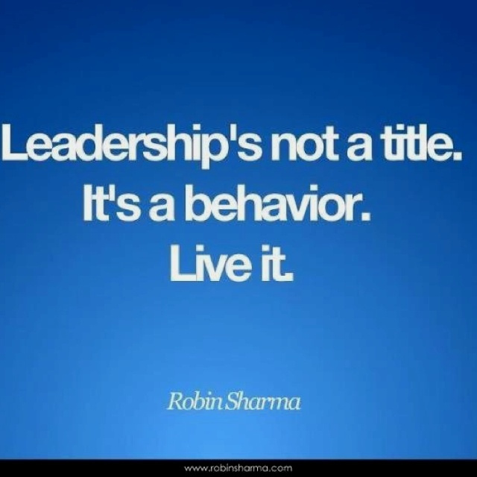

Slide 47


